Slide 1
Nearest Neighbour of Different Image Representation
Presented by Ankur Chowdhury (1911844042)
& Sajid Wasif (1912313642)

Slide 2
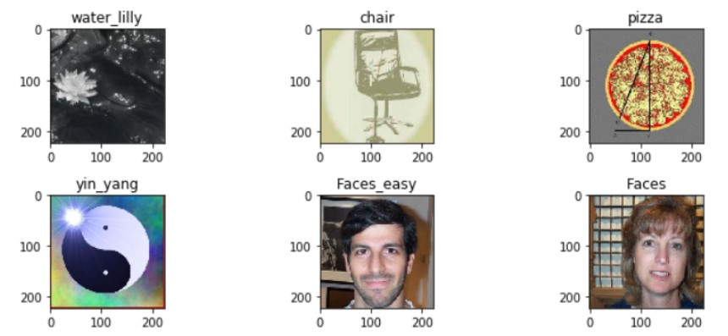
PROJECT DESIGN
Data understanding and Transfer learning
Our goal is to query any given image and find a semantically similar image or the nearest 10 images and what they represent in the CIFAR-100 Database. This database contains 100 classes containing 600 images each.
we will use a pre-trained ResNet 34 network which is trained on the ImageNet database and transfer learn it to classify 100 categories of CIFAR-100 database.
Load the data using dataset loaders
Take a pre-trained network, in this case, a ResNet 34 and remove its last fully connected layers
Add new fully connected layers at the end of the network and train only those layers using the CIFAR-100 image, while keeping all the other layers frozen
Train the entire network by unfreezing all the layers

Slide 3
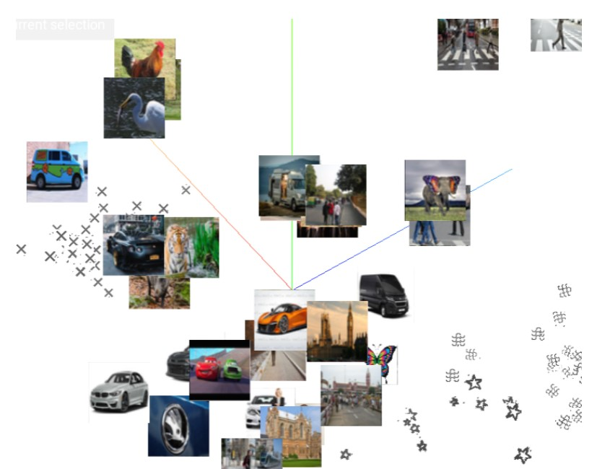
Extracting image embeddings
We must extract embeddings from the pre-trained network for each of our CIFAR-100 photos. In this instance, an image embedding is an N-dimensional representation of a picture.
We will acquire picture embeddings from a ResNet-34 by taking the output of its second last Fully-connected layer which has a size of 512.We want to use Pytorch forward Hooks in order to extract embeddings. Forward hooks are necessary for the inference stage since we need the output from our second-to-last fully connected layers.

Slide 4
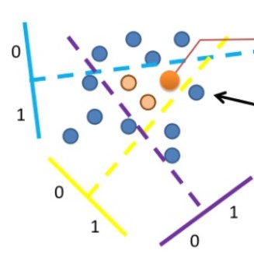
Nearest neighbor search
We'll use the approximate nearest neighbor algorithm known as locality sensitive hashing (LSH), which reduces the computational complexity to O(logN).
LSH will run an ANN search. We will use LSH to build a hash for a new image embedding after which we will measure the separation between the images in the Caltech-101 dataset that have the same hash value.

Slide 5
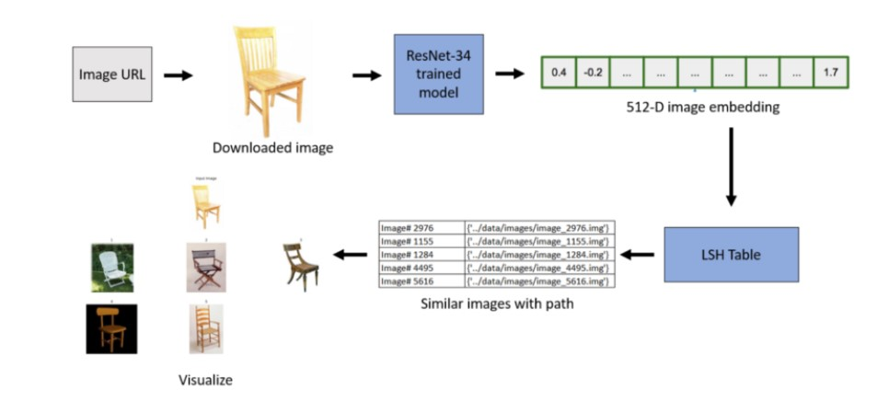
Putting it all together
After creating LSH table we will take an image URL as an input and give us N(user-defined) similar images from CIFAR-100 database

Slide 6
Thank you

